Slide 1
Employee Data Analysis using Excel
STUDENT NAME: DIMPLE SANGEETHA.M
REGISTER NO: 122203513
NAN MUDHALVAN USER ID: asunm1475122203513
DEPARTMENT: Department of Commerce (Corporate Secretaryship)
COLLEGE: SRI KANYAKA PARAMESWARI ARTS & SCIENCE COLLEGE FOR WOMEN.

Slide 2
PROJECT TITLE
Employee Performance Analysis using Excel

Slide 3


AGENDA
Problem Statement
Project Overview
End Users
Our Solution and Proposition
Dataset Description
Modelling Approach
Results and Discussion
Conclusion
3/21/2024 Annual Review

Slide 4
PROBLEM STATEMENT Employee performance analysis is done for several important reasons: 1. Identify Strengths and weakness 2. Improve Productivity 3. Optimise Talent Management 4. Enhance Employee Development 5. Increase Employee Engagement 6. Support Strategic Planning 7. Reduce Turnover and Improve Retention 8. Ensure Fair and Transparent. By conducting employee performance analysis, organisation can create a more productive, motivated, and satisfied workforce, which is essential for long –term success and competitiveness.

Slide 5

PROJECT OVERVIEW
What is Employee Data analysis?
Employee data analysis is the systematic examination of data related to employees to gain insights into various aspects of the workforce. This type of analysis involves collecting, processing, and analyzing data from various sources to understand employee Gender, performance level, ratings and their achievements and overall workforce dynamics.

Slide 6




WHO ARE THE END USERS? 1. Human Resources Team 2. Manager and Team Leaders 3. Senior Executives 4. Employees 5. IT and Data Teams 6. Board of Directors.

Slide 7
OUR SOLUTION AND ITS VALUE PROPOSITION TECHNIQUES USED: 1. CONDITIONAL FORMATTING: Conditional Formatting is used to highlight the missing values. 2. FILTERING OPTION: Filtering option is used to remove the missing values or filter out. 3. FORMULA: Formula is used to calculate the employees performance level. 4. PIVOT TABLE: Pivot table is used for summarizing. 5. GRAPH: Graph is used for Data Visualization.

Slide 8
Dataset Description EMPLOYEE DATASET: Employee data set was downloaded from Edu net dashboard. TOTAL NO. OF FEATURES: 26 Features. I have taken for project was: 11 Features. 1. Employee ID : Employee ID is in Numerical form. 2. First Name : First Name is in Text form. 3. Costa : Costa is in Text form. 4. Business Unit : Business Unit is in Text form. 5. Employee Status : Employee status is in Text form. 6. Employee Type : Employee Type is in Text Form. 7. Employee Classification Type : It is in Text Form. 8. Gender Code : Gender code is in Text form (I.e., Male, Female) 9. Performance Score: It is in Text form. 10. Current Employee Rating : It is used in numeric form. 11. Performance level : It is in Text form which is converted from current employee ratings through using formula.

Slide 9

THE "WOW" IN OUR SOLUTION
Performance Level: =IFS(Z8>=5,”VERY HIGH”,Z8>=4,”HIGH”,Z8>=3,”MEDIUM”,TRUE,”LOW”)
3/21/2024 Annual Review
9

Slide 10
MODELLING
1. Data Collection :
The Data is collected from the Edu net Dashboard.
2. Features collection :
In features there are 26 features totally and I have identified only 11 features for my ppt project. like First Name, Gender , Employee ID, etc.
3. Data Cleaning :
In Data cleaning first I have founded the missing have using conditional formatting option and then filtered that missing values using filter option.
4. Performance Level :
I have founded performance level value with the current employee ratings column using formula.
5. Pivot Table :
Pivot Table is used for summary to describe the data in a chart form.
6. Visualization :
I have given chart title in the chart. Pivot table shows the high, low, medium, very high and linear(Medium) employee performance level.
10

Slide 11
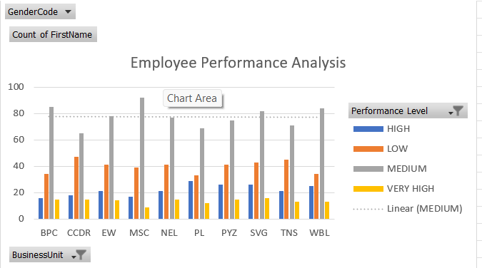
RESULTS
11

Slide 12
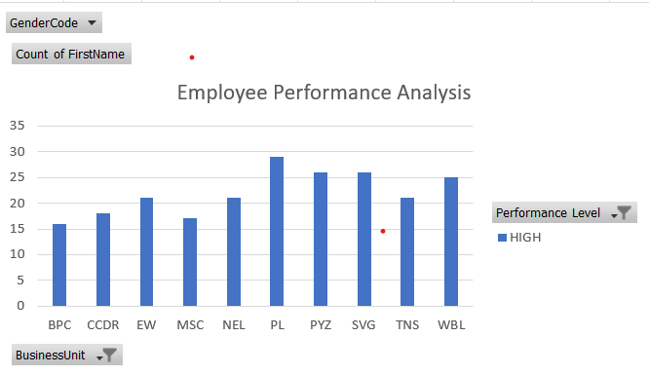
RESULT HIGH PERFORMANCED EMPLOYEES

Slide 13
Conclusion By Comparing the performance of the Employees the number of employees are higher in medium level in the working organization so, we want to motivate them to performance well. The employee in very high level are low in percentage so we need to motivate the employees by giving different tasks and levels. Giving right level of Job to right person is more important because every employee or every individual has their different capacity.

Slide 14

Conclusion

